Slide 1
FIFA 2K19

Slide 2

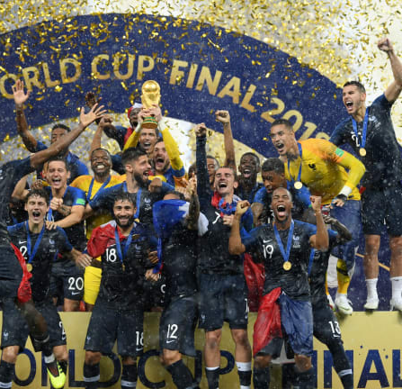
Introduction
FIFA is one of the most famous sport in the world.
More than half of the world saw the famous 2018 world cup.
Audit tells the total viewership of 3.572 billion for the last world cup.

Slide 3
The show goes on…
After 2018 world cup, FIFA entered new era.
3 Major leagues with total of 72 clubs.
FIFA 19 Global Series – generated more than 680 million minutes watched and 61 million total views.
This represents an annual increase of 60% and 25% respectively.

Slide 4



Some Famous Clubs

Slide 5
Fifa 19 Data
The Data is taken from Kaggle.
It has 3 unique tables
Each table has 2000 rows and 26 columns
The reason for taking this Dataset is because it has a usability rating of 10 in Kaggle and we all are big fans of football and fifa as we watch it every year.

Slide 6
Power BI Modelling
Created Relationships between Tables
Converted Data Types from text to numbers and numbers to text
Created calculated Measures and Columns
Manipulating data in Excel before visualizing in Power BI

Slide 7
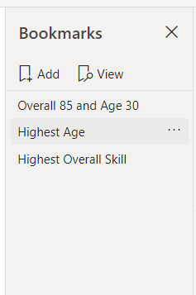
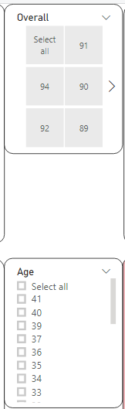
Report Functionality and Interactivity
Use of Slicer
Use of Bookmarks
Use of Interactivity in all visualizations as selecting one data point in a visualization will result in selecting other similar data point in other visualizations.

Slide 8
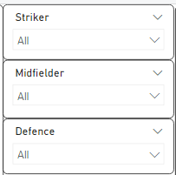
How a client will use my report
By using slicers
By using bookmarks
By using Play Axis Visualizations
By using Key Influencers
By using Interactions

Slide 9
Key Findings and Insights
Top overall skilled players in football are Cristiano Ronaldo and Lionel Messi.
Top Clubs with highest international reputation are Chelsea and FC Bayern.
55% players have normal body type and 30% players lean body type and 10% have stocky body type in football.
Highest Wage earning player is Lionel Messi with 565000 wages.
Acceleration and power shot ability of football players decrease as age increase.
The football player with most weight is L.Unnerstall with 227lbs.

Slide 10
The football player with the most potential is K. Mbappe that is 95.
Potential of a club will increase when the value of the club is between 16-118.5 Million.

Slide 11


